Slide 1
Measuring Time Series
Forecasting Errors
Renato R. Maaliw III, DIT
Professor 1, College of Engineering
Southern Luzon State University
Lucban, Quezon, Philippines

Slide 2

Motivation:
Forecasting is at the heart of predictions. Accurately forecasting the future drives strategic actions, yet no forecast is perfect.

Slide 3
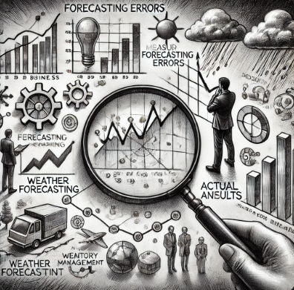
Motivation:
Understanding & measuring forecasting errors is essential, it provides a quantitative way to evaluate how close our predictions to reality.

Slide 4
Why Measure
Forecasting Errors?

Slide 5

1. Model Selection
Error metrics act as benchmarks that allow us to compare different model’s performance objectively.

Slide 6

2. Risk Management
Forecast errors are a reality, but by quantifying them, we can better assess and manage the risks involved.

Slide 7
Key Measures of
Forecasting Errors

Slide 8
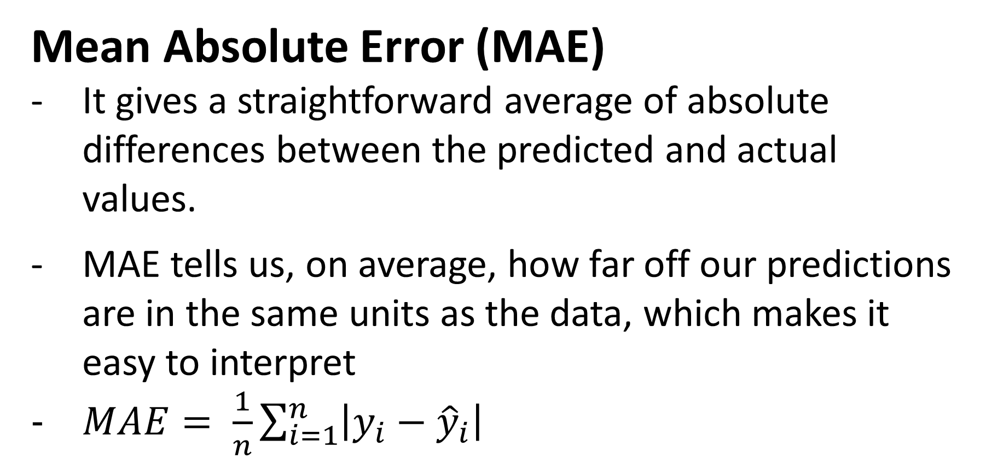
Mean Absolute Error (MAE)
It gives a straightforward average of absolute differences between the predicted and actual values.
MAE tells us, on average, how far off our predictions are in the same units as the data, which makes it easy to interpret
$MAE= \frac{1}{n}\sum_{i=1}^{n}{\left|y_{i}−{\hat{y}}_{i}\right|}$

Slide 9
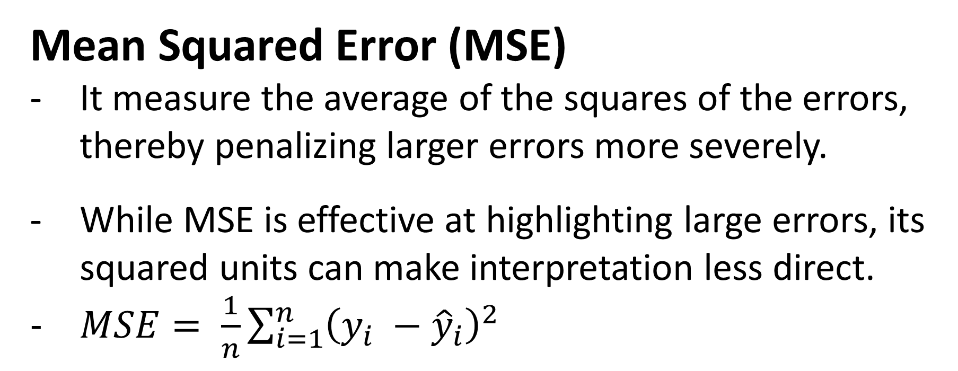
Mean Squared Error (MSE)
It measure the average of the squares of the errors, thereby penalizing larger errors more severely.
While MSE is effective at highlighting large errors, its squared units can make interpretation less direct.
$MSE= \frac{1}{n}\sum_{i=1}^{n}{{\left(y_{i} −{\hat{y}}_{i}\right)}^{2}}$

Slide 10
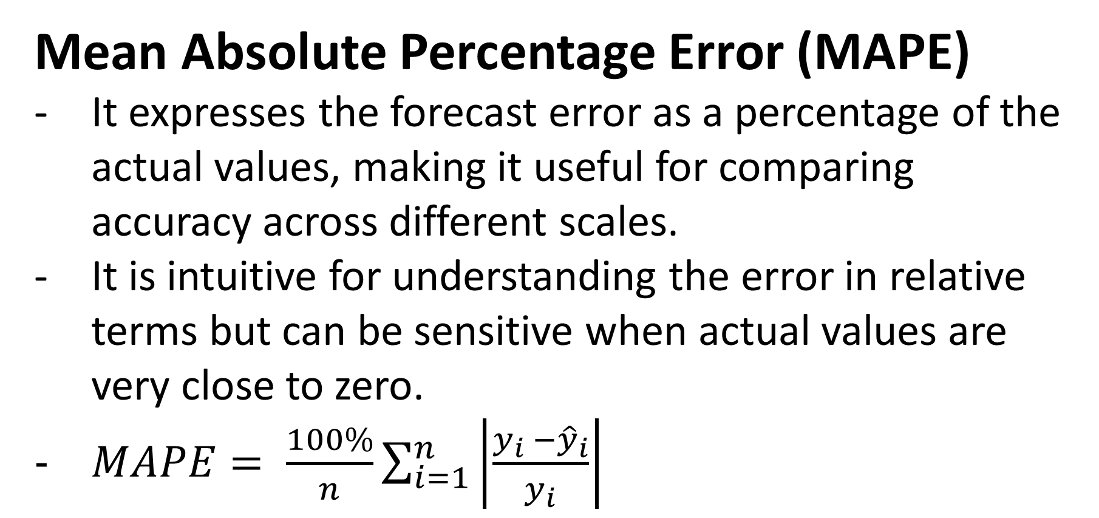
Mean Absolute Percentage Error (MAPE)
It expresses the forecast error as a percentage of the actual values, making it useful for comparing accuracy across different scales.
It is intuitive for understanding the error in relative terms but can be sensitive when actual values are very close to zero.
$MAPE= \frac{100\%}{n}\sum_{i=1}^{n}{\left|\frac{y_{i} −{\hat{y}}_{i}}{y_{i}}\right|}$

Slide 11
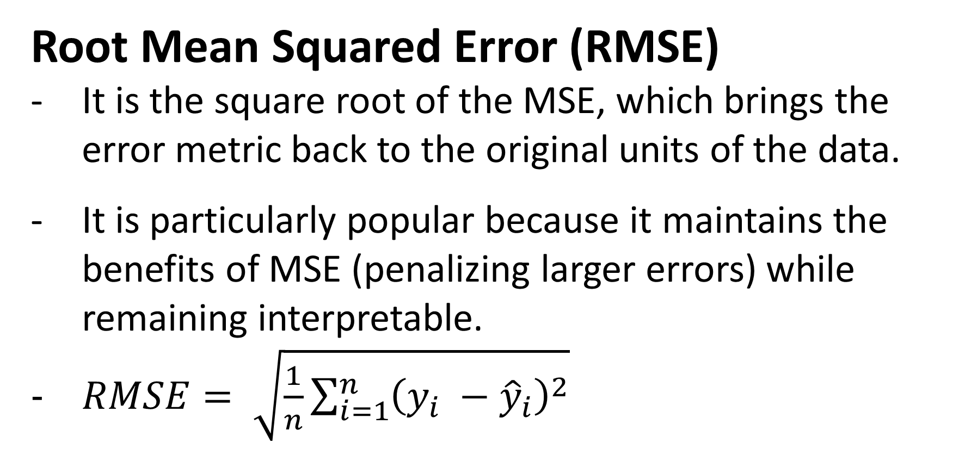
Root Mean Squared Error (RMSE)
It is the square root of the MSE, which brings the error metric back to the original units of the data.
It is particularly popular because it maintains the benefits of MSE (penalizing larger errors) while remaining interpretable.
$RMSE= \sqrt{\frac{1}{n}\sum_{i=1}^{n}{{\left(y_{i} −{\hat{y}}_{i}\right)}^{2}}}$

Slide 12
Examples

Slide 13
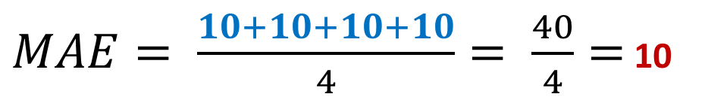
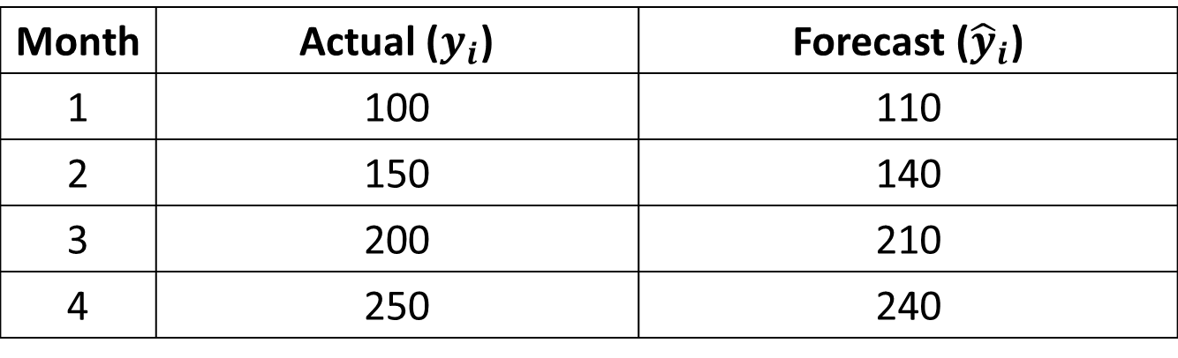
Month | Actual ($y_{i}$) | Forecast (${\hat{y}}_{i}$)
1 | 100 | 110
2 | 150 | 140
3 | 200 | 210
4 | 250 | 240
Month 1: 100 − 110 = 10 (absolute)
Month 2: 150 − 140 = 10 (absolute)
Month 3: 200 − 210 = 10 (absolute)
Month 4: 250 − 240 = 10 (absolute)
$MAE= \frac{10+10+10+10}{4}= \frac{40}{4}=$ 10
Interpretation: On average, the forecast is off by 10 units

Slide 14
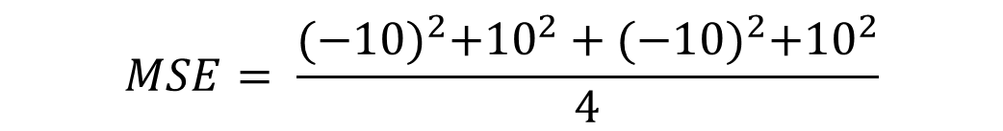
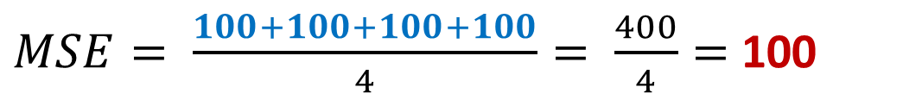
Month | Actual ($y_{i}$) | Forecast (${\hat{y}}_{i}$)
1 | 100 | 110
2 | 150 | 140
3 | 200 | 210
4 | 250 | 240
Month 1: 100 − 110 = -10
Month 2: 150 − 140 = 10
Month 3: 200 − 210 = -10
Month 4: 250 − 240 = 10
$$MSE= \frac{{(−10)}^{2}+{10}^{2}+{(−10)}^{2}+{10}^{2}}{4}$$
$MSE= \frac{100+100+100+100}{4}= \frac{400}{4}=$ 100
Interpretation: On average, the square of the error is 100, emphasizing larger errors.

Slide 15
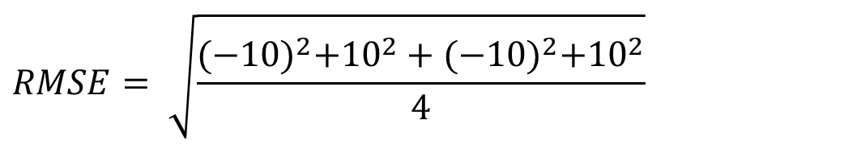
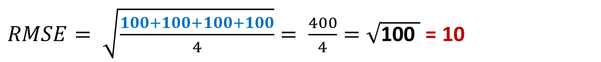
Month | Actual ($y_{i}$) | Forecast (${\hat{y}}_{i}$)
1 | 100 | 110
2 | 150 | 140
3 | 200 | 210
4 | 250 | 240
Month 1: 100 − 110 = -10
Month 2: 150 − 140 = 10
Month 3: 200 − 210 = -10
Month 4: 250 − 240 = 10
$$RMSE= \sqrt{\frac{{(−10)}^{2}+{10}^{2}+{(−10)}^{2}+{10}^{2}}{4}}$$
$RMSE= \sqrt{\frac{100+100+100+100}{4}}= \frac{400}{4}=\sqrt{\text{100} }$ = 10
Interpretation: The RMSE is 10, matching the MAE

Slide 16
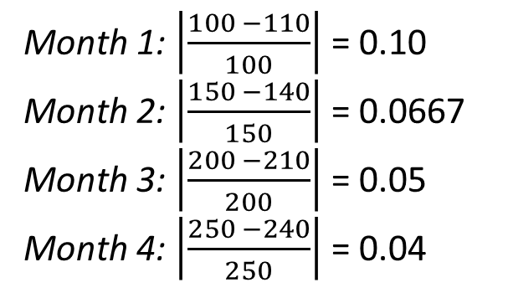
Month | Actual ($y_{i}$) | Forecast (${\hat{y}}_{i}$)
1 | 100 | 110
2 | 150 | 140
3 | 200 | 210
4 | 250 | 240
Month 1: $\left|\frac{100 −110}{100}\right|$ = 0.10
Month 2: $\left|\frac{150 −140}{150}\right|$ = 0.0667
Month 3: $\left|\frac{200 −210}{200}\right|$ = 0.05
Month 4: $\left|\frac{250 −240}{250}\right|$ = 0.04
$$MAPE= \frac{0.10+0.0667+0.05+0.04}{4}=\frac{0.2567}{4}=0.0642$$
$$MAPE= 0.0642 ∗100=6.42\%$$
Interpretation: On average, the forecast is off by about 6.42% relative to the actual values

Slide 17
Takeaway
MAE gives the average error in the same units as the data.
MSE penalizes larger errors more by squaring them.
RMSE brings MSE back to the original units, offering a clear view of the error magnitude.
MAPE expresses errors as percentage, making it easier to compare across different scales.

Slide 18
Various Cases

Slide 19
Example 1:
Sensitivity to Outliers

Slide 20
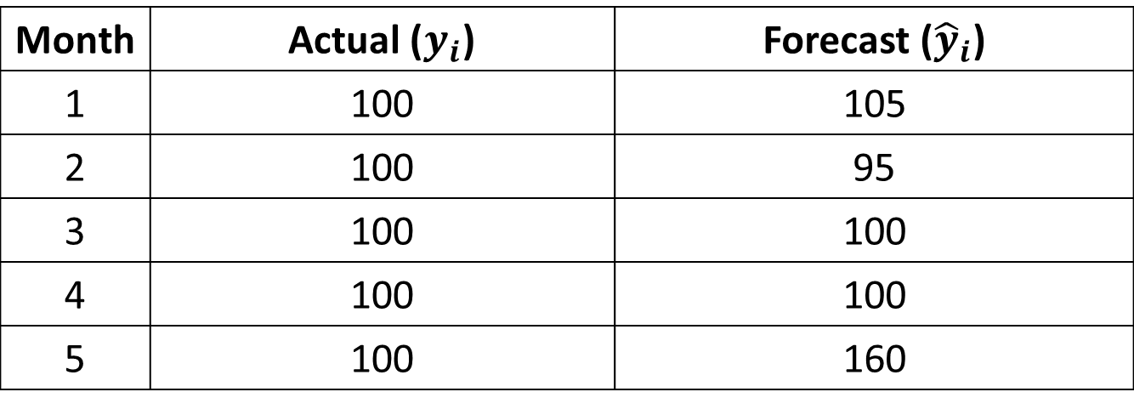
Month | Actual ($y_{i}$) | Forecast (${\hat{y}}_{i}$)
1 | 100 | 105
2 | 100 | 95
3 | 100 | 100
4 | 100 | 100
5 | 100 | 160
MAE: Forecast is off by 14 units
MSE: Squaring the errors exaggerates the outlier, resulting in high MSE
RMSE: Indicates a larger average error when the large deviation is considered
MAPE: Shows a 14% average deviation, but note it doesn’t reflect the squared impact of the outlier as seen in MSE and RMSE
MAE: 14
MSE: 730
RMSE: 27.02
MAPE = 14%

Slide 21
Insight
MAE and MAPE suggest a moderate average error.
MSE and RMSE are heavily influenced by the outlier.
Voting-based decision: In this case, if you looked at MAE or MAPE, you might underestimate the risk of the extreme error. Considering all metrics helps reveal that while most forecasts are accurate, one large error skews the overall performance significantly.

Slide 22
Example 2:
Near-Zero Actual Values

Slide 23
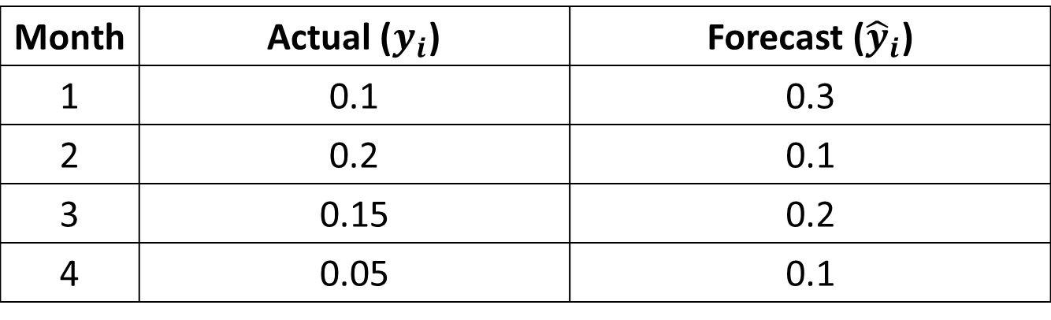
Month | Actual ($y_{i}$) | Forecast (${\hat{y}}_{i}$)
1 | 0.1 | 0.3
2 | 0.2 | 0.1
3 | 0.15 | 0.2
4 | 0.05 | 0.1
MAE: Forecast is off by 0.1
MSE: Squared error remains small due to the low absolute errors
RMSE: Similar to MAE in this instance
MAPE: Appears extremely high, nearly 96%, which can be misleading given the very small scale of the actual values.
MAE: 0.1
MSE: 0.01375
RMSE: 0.117
MAPE = 95.83%

Slide 24
Insight
MAE, MSE, and RMSE indicate relatively small errors in absolute terms.
MAPE is inflated due to division by numbers close to zero, potentially distorting the true performance of the model.
Voting-based decision: By considering all metrics, you see that percentage-based errors (MAPE) may not be reliable in contexts with near-zero actuals. Relying solely on MAPE would misguide model evaluation, while the combination of MAE, MSE, and RMSE gives a more balanced view.

Slide 25
Conclusion

Slide 26
Outlier Sensitivity: RMSE and MSE can be heavily influenced by extreme values, while MAE and MAPE might understate the risk.
Scale Distortion: MAPE can be misleading when actual values are near zero, whereas MAE, MSE, and RMSE maintain their scale integrity.

Slide 27
Solution:
Aggregate the insights: Identify if most metrics point to similar conclusion.
Understand context: Consider the nature of your data (presence of outliers, scale issues) to decide which metrics should have more influence
Balance trade-offs: No single metric captures all nuances. A combined judgment reduces the risk of over fitting your model evaluation to a single dimension.

Slide 28
Other Methods:
Mean Absolute Scaled Error (MASE)
Scales the forecast errors by the in-sample error of a naïve forecasting model (often a simple random walk).
Scale-independence: It allows you to compare errors across different datasets or time series.
Robustness: It doesn’t blow up when actual values are close to zero.

Slide 29
Other Methods:
Symmetric Mean Absolute Percentage Error (MASE)
It modifies the MAPE by using the average of the absolute values of the actual and forecasted values in the denominator, reducing sensitivity when values are small.
Symmetry: It treats over-forecasts and under-forecasts more equally
Reduced bias: It mitigates the extreme percentage errors that can occur in MAPE when actual values approach zero.

Slide 30
Other Methods:
Theil’s U Statistic
It compares the accuracy of your forecasting model to that of a naïve model (such as the “no change” model). A value of less than 1 indicates that your model outperforms the naïve benchmark.
Benchmarking: It provides context by comparing your model against a simple alternative, which can be particularly insightful for time series data.

Slide 31
[Code Demo]

Slide 32
Thank you very much for listening.

